Slide 1
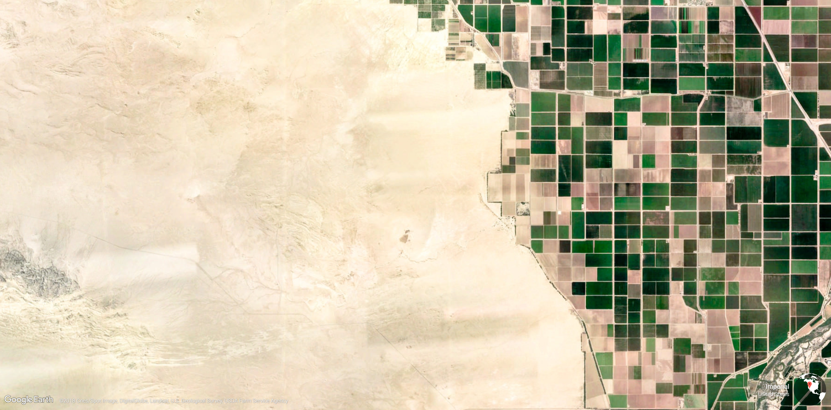






{NLMR} and {landscapetools}
Simulating and modifying neutral landscape models
Cédric Scherer in collaboration with Marco Sciaini, Matthias Fritsch, Maximillian H.K. Hesselbarth, Sebastian Hanss, Jakub Nowosad & Craig E. Simpkins
cedricphilippscherer@gmail.com cedricscherer.netlify.com @CedScherer Z3tt

Slide 2

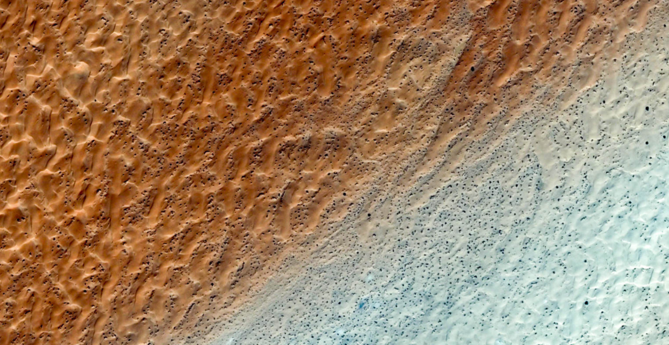
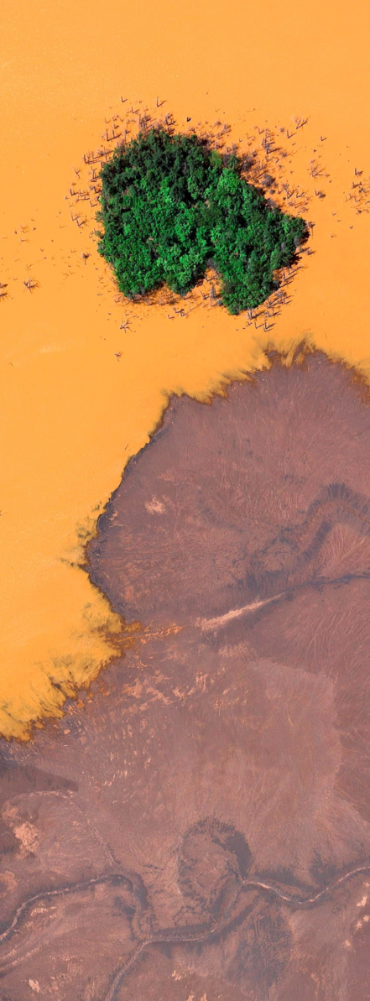
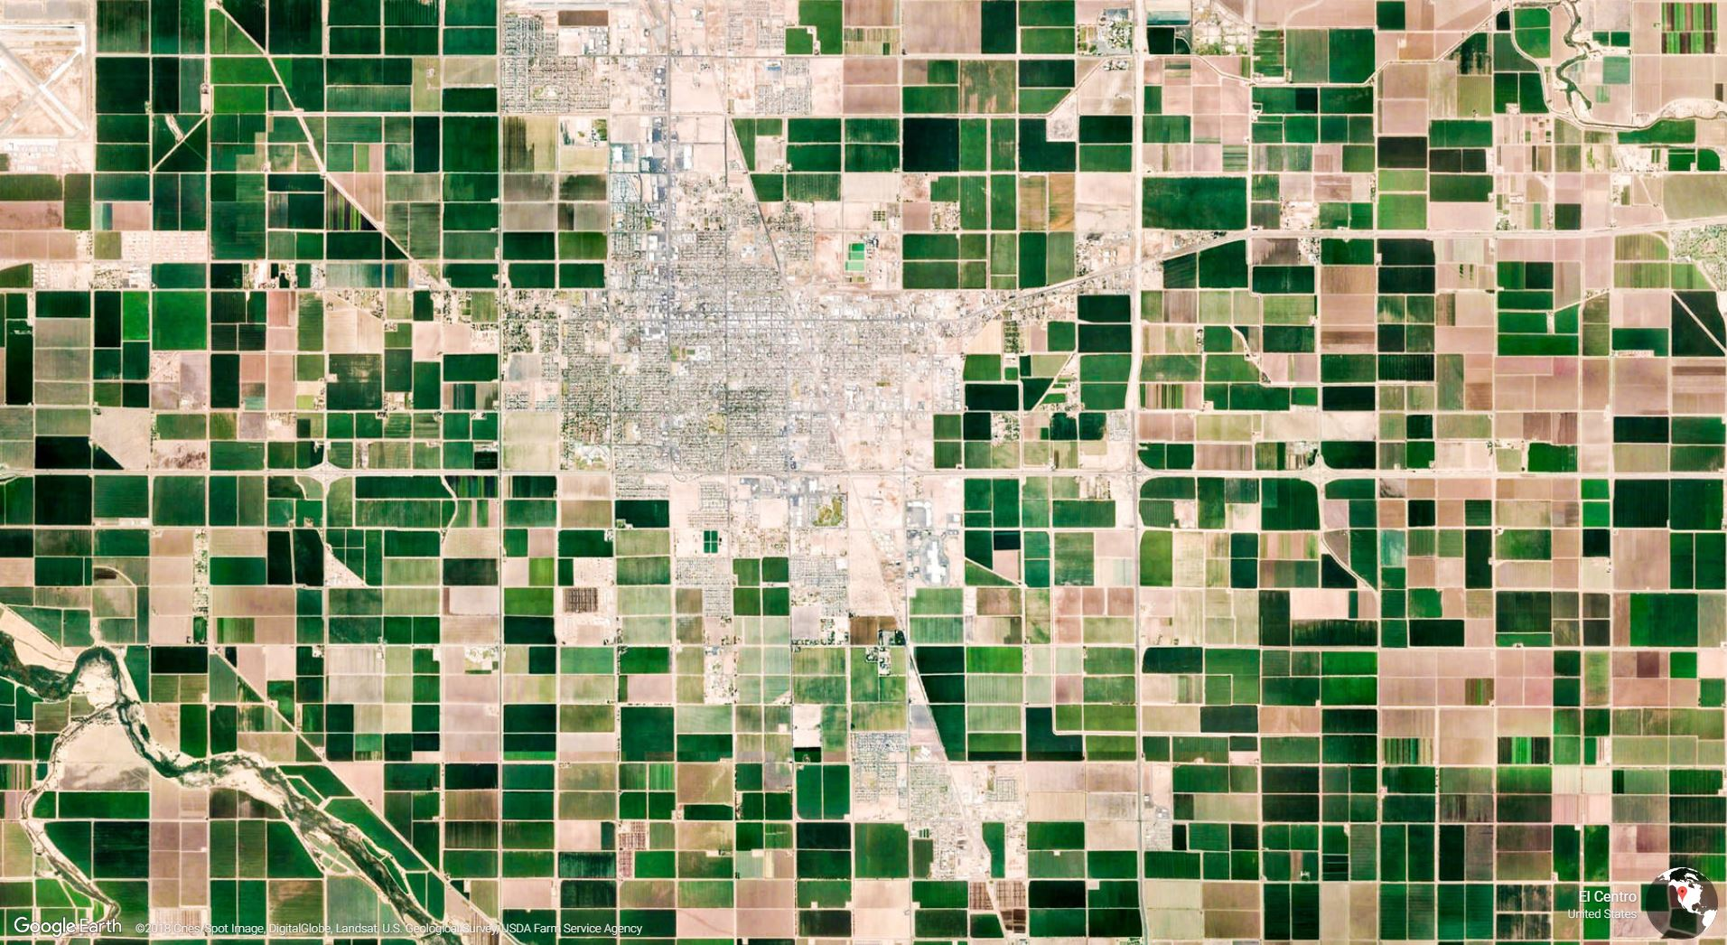
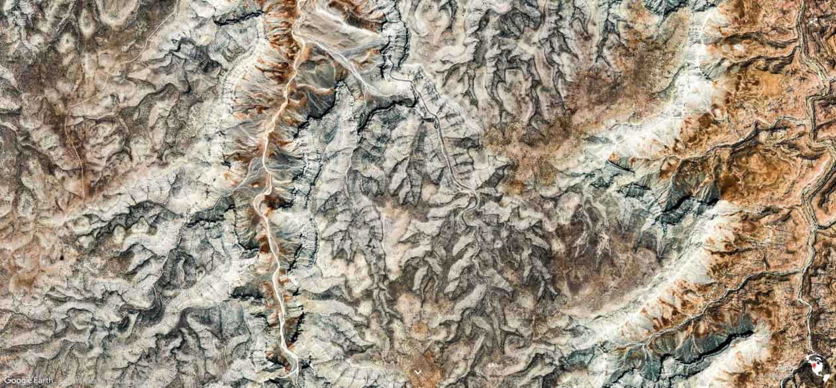
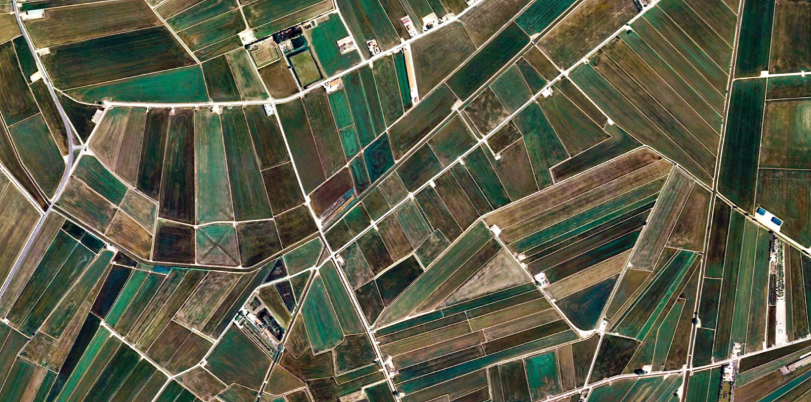
Cédric Scherer cedricscherer.netlify.com @CedScherer
Cédric Scherer cedricscherer.netlify.com @CedScherer

Slide 3

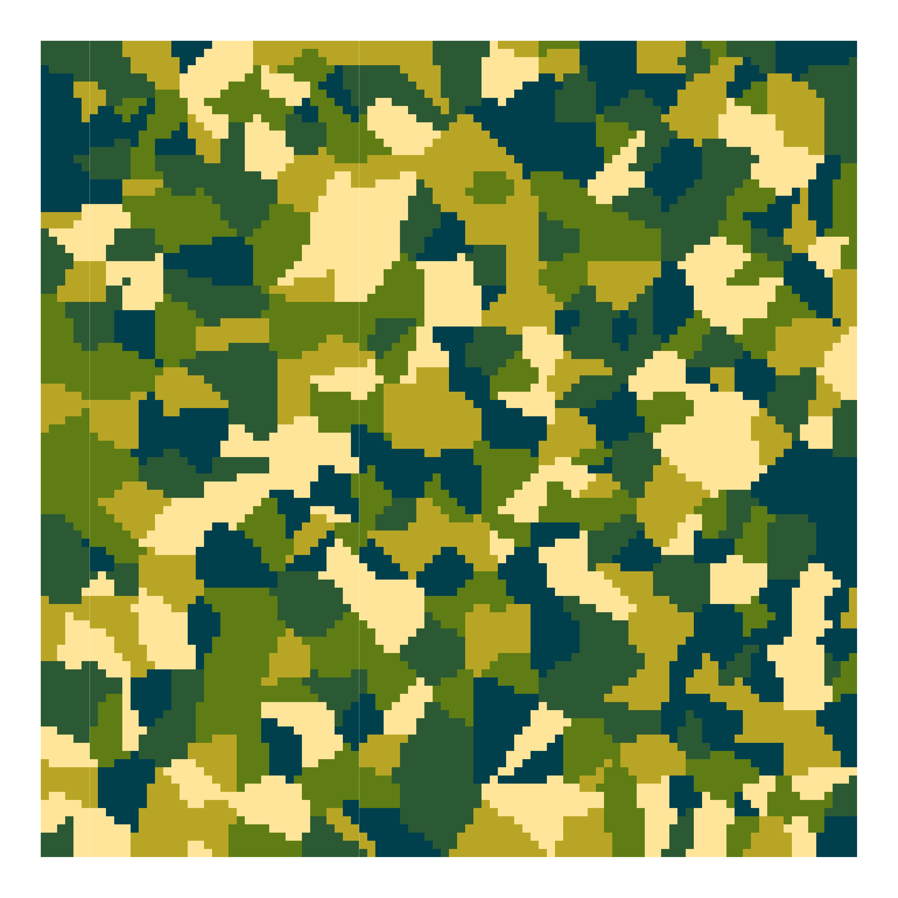
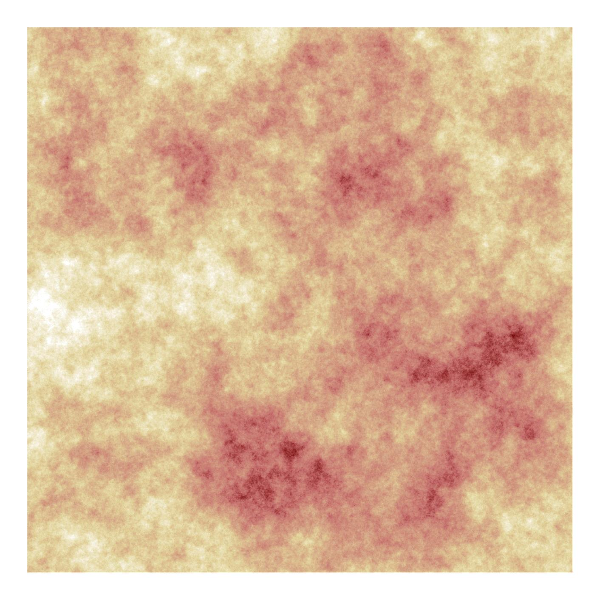
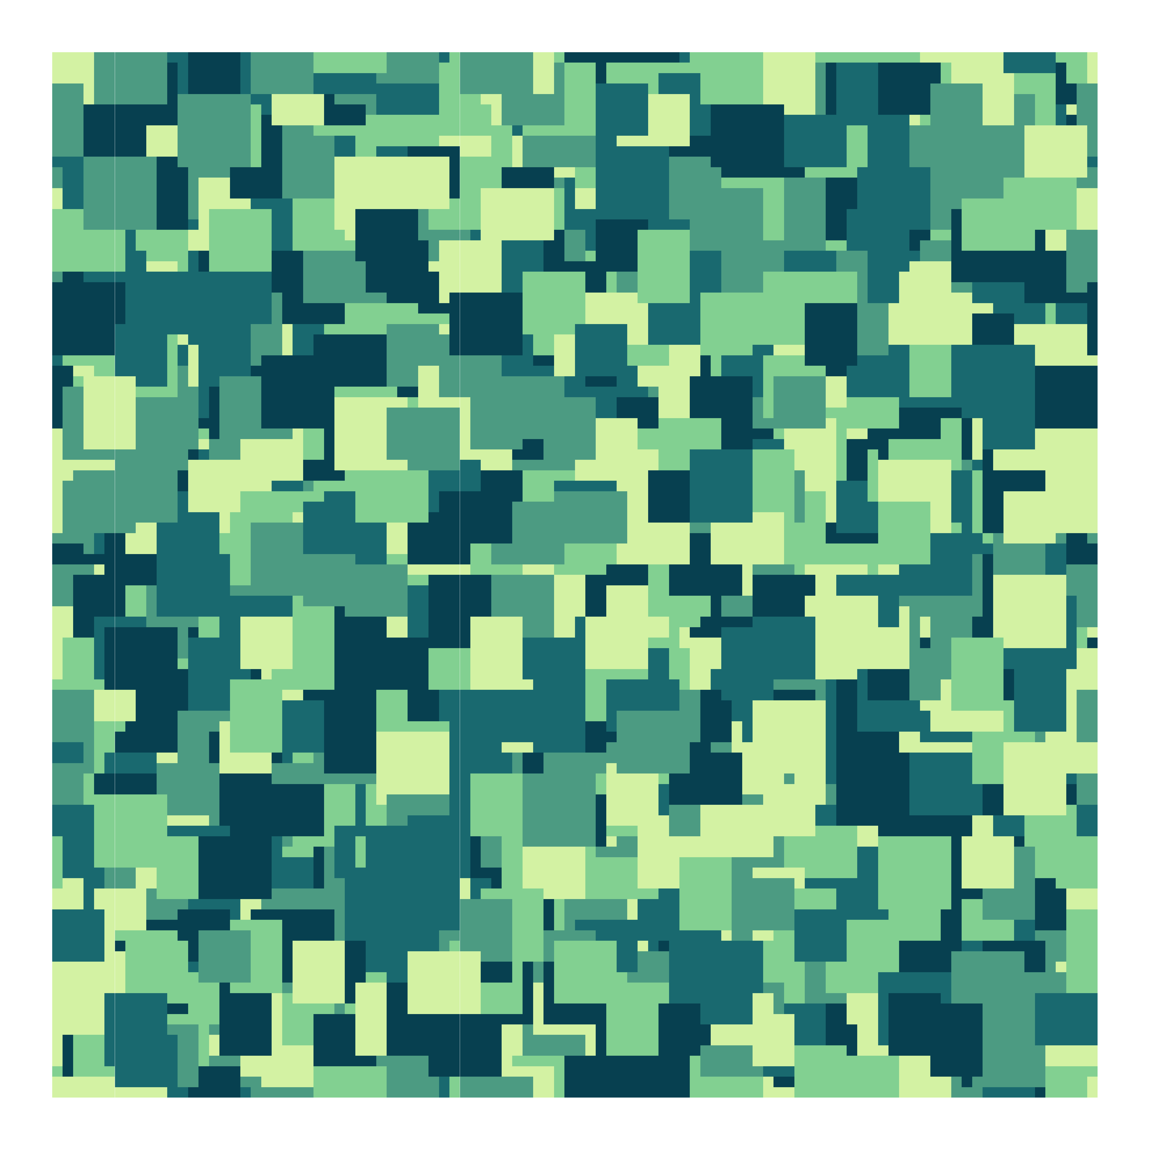
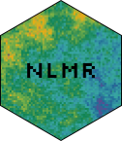

Cédric Scherer cedricscherer.netlify.com @CedScherer

Slide 4
Neutral Landscape Models (NLMs) Algorithms which generate landscape patterns based on theoretical distributions
Cédric Scherer cedricscherer.netlify.com @CedScherer

Slide 5
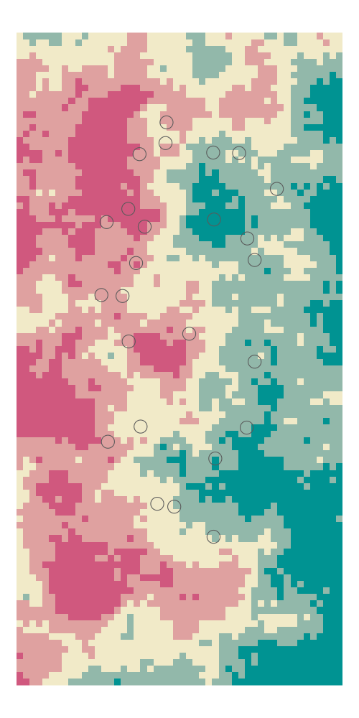
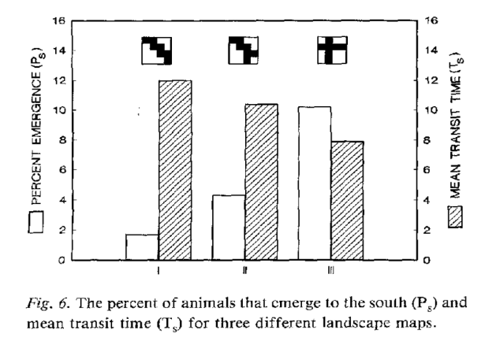
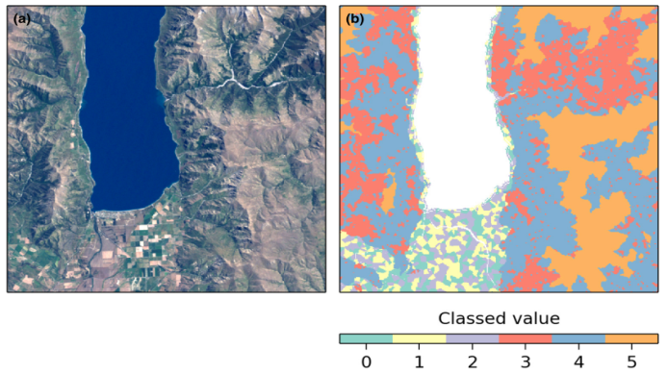


NLMs in Landscape Ecology
Three use cases for Neutral Landscape Models
coupling with models to predict changes in ecological processes
analysis of structural deviation between real and neutral landscapes
development and testing of novel landscape metrics
a)
b)
c)
Gardener, O’Neill, Turner & Dale (1989) Landscape Ecology 3:217–227
Etherington et al. (2015) Methods in Ecology & Evolution 6:164–168
GIF by Marco Sciaini
Notes:
three uses for NLMs (With & King 1997, Turner & Gardner 2015)
coupling with models to predict changes in ecological processes,
analysis of structural deviation between real and neutral landscapes, and
development and testing of novel landscape metrics

Slide 6
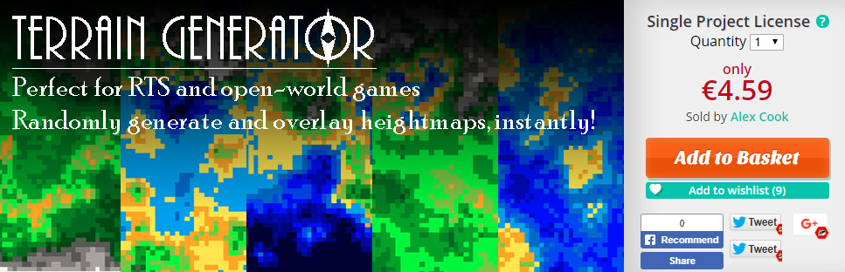
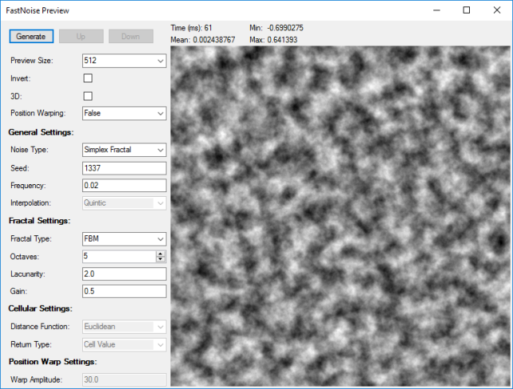
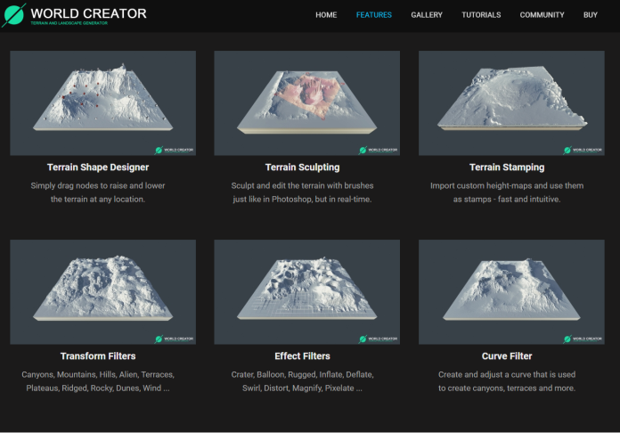
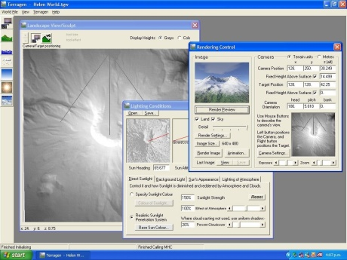

NLMs in Other Disciplines
"Terrain Generator" "World Creator" "Map Generator" Noise Generator Wallpaper Art?
scirra.com/store/royalty-free-game-templates/terrain-generator-1774
Terragen 4
planetside.co.uk
Terragen Classic
github.com/Auburns/FastNoise
world-creator.com
Notes:
three uses for NLMs (With & King 1997, Turner & Gardner 2015)
coupling with models to predict changes in ecological processes,
analysis of structural deviation between real and neutral landscapes, and
development and testing of novel landscape metrics

Slide 7
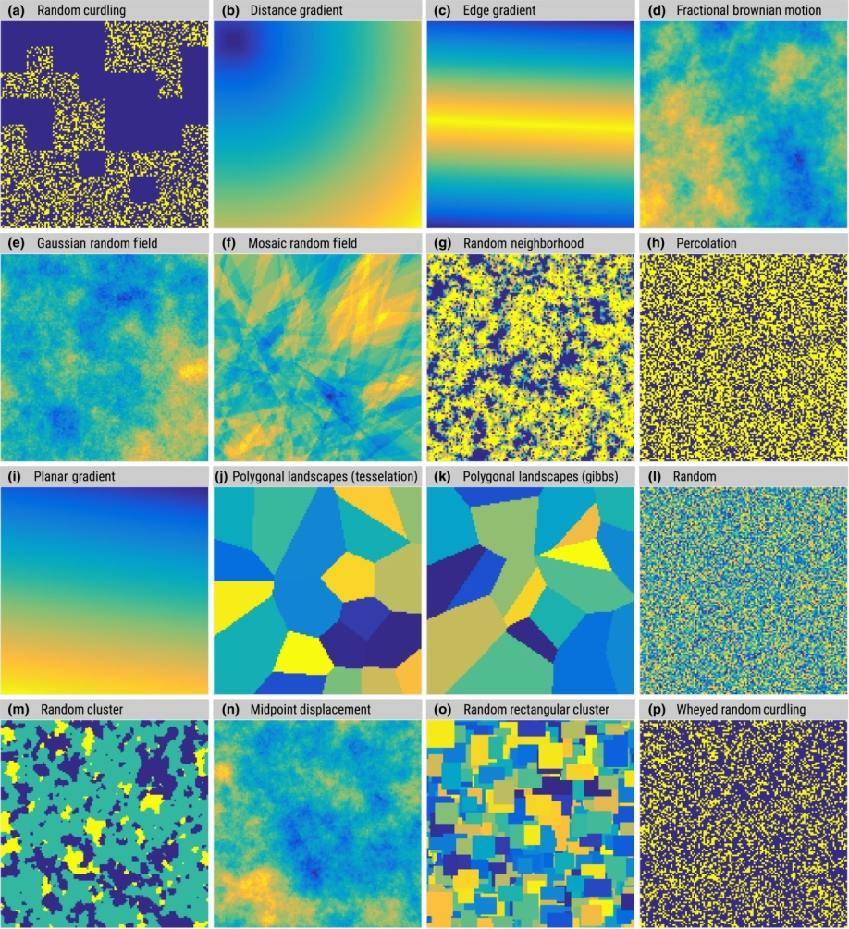


{NLMR}
R package for simulating neutral landscape models
Allows for a self-contained, reproducible workflow
Widest collection of algorithms with several options to simulate deviates
Modification with landscapetools

Slide 8
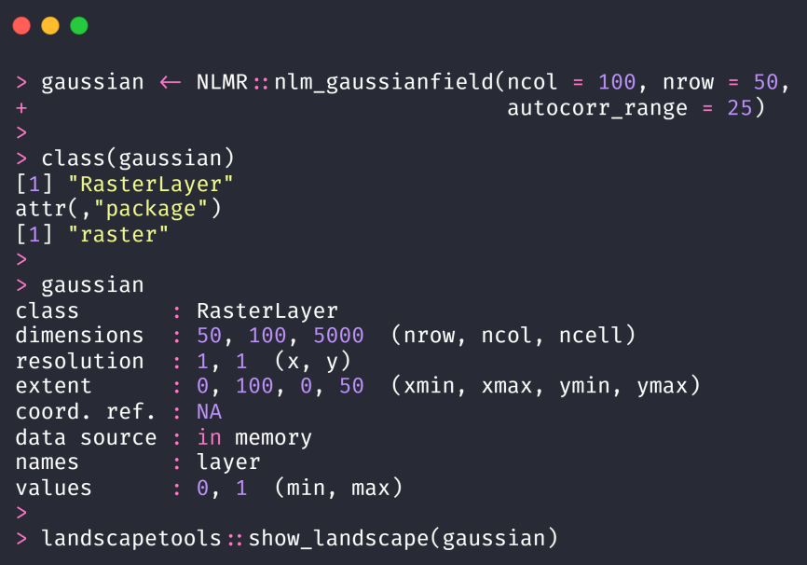
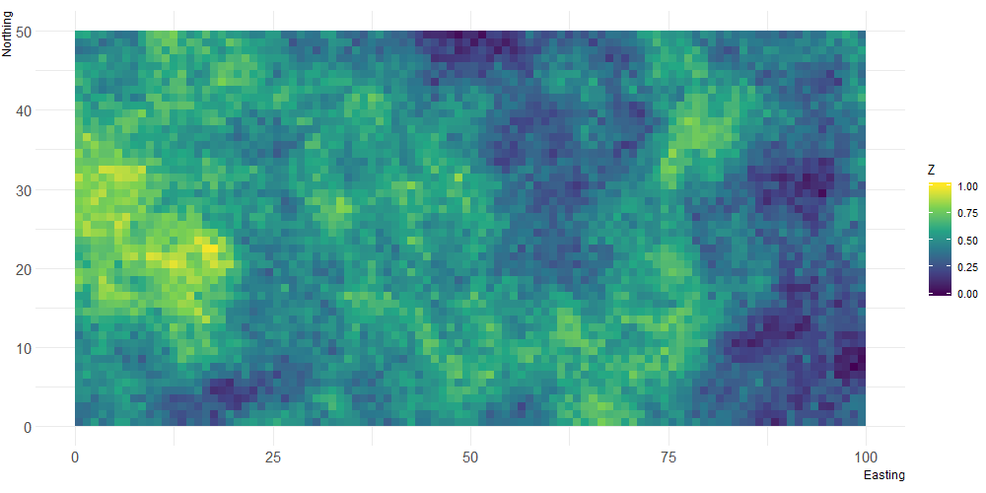
{NLMR}
Hosted on CRAN and ROpenSci: install.packages("NLMR") devtools::install_github("ropensci/NLMR")
Syntax: NLMR::nlm_algorithm(ncol, nrow, ...)
Always returns RasterLayers

Slide 9

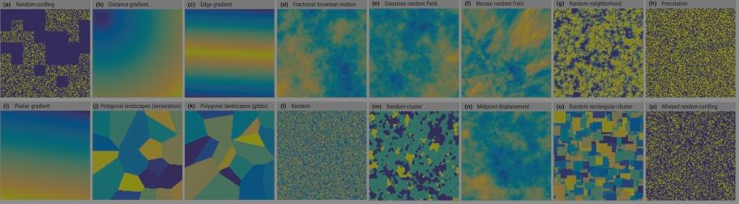
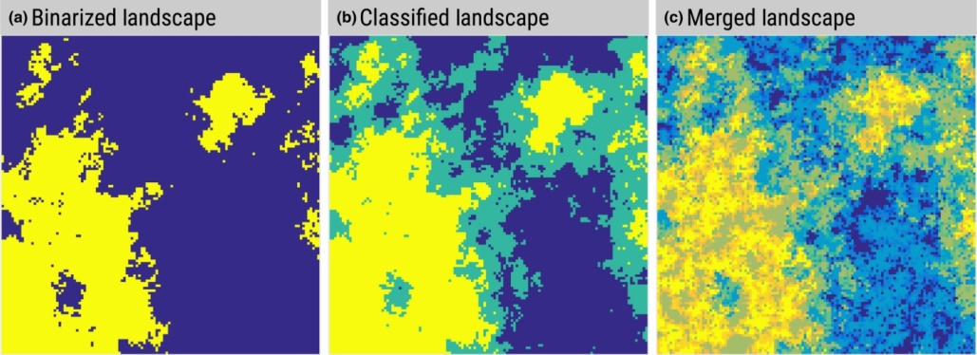
{landscapetools}
NLMR
R package with utility functions for landscape analyses (raster objects)
Hosted on CRAN and ROpenSci: install.packages("landscapetools") install_github("ropensci/landscapetools")
3 types of functions: landscapetools::util_*() landscapetools::show_*() landscapetools::theme_nlmr_*()
landscapetools

Slide 10
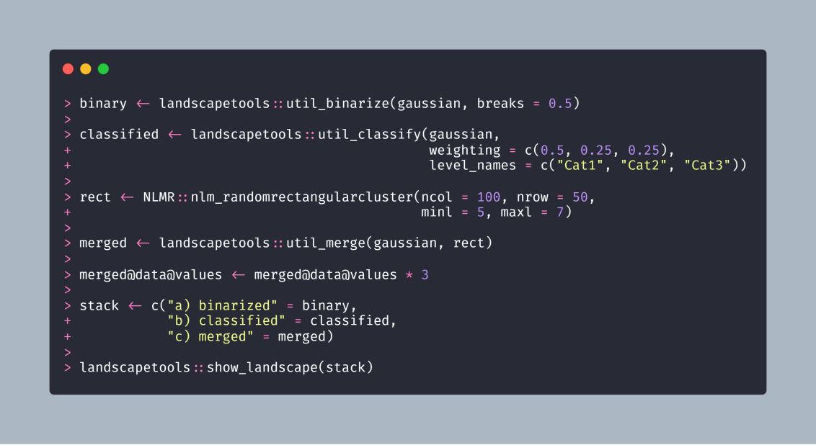
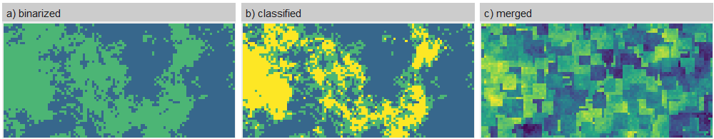
{landscapetools}
R package with utility functions for rasters:
util_binarize()
util_classify()
util_merge()
util_rescale()
util_as_integer()
util_raster2tibble(), util_tibble2raster()
util_writeESRI()
show_landscape(), theme_nlm_grey(), ...

Slide 11
{landscapetools}
R package with utility functions for rasters:
util_binarize()
util_classify()
util_merge()
util_rescale()
util_as_integer()
util_raster2tibble(), util_tibble2raster()
util_writeESRI()
show_landscape(), theme_nlm_grey(), ...

Slide 12
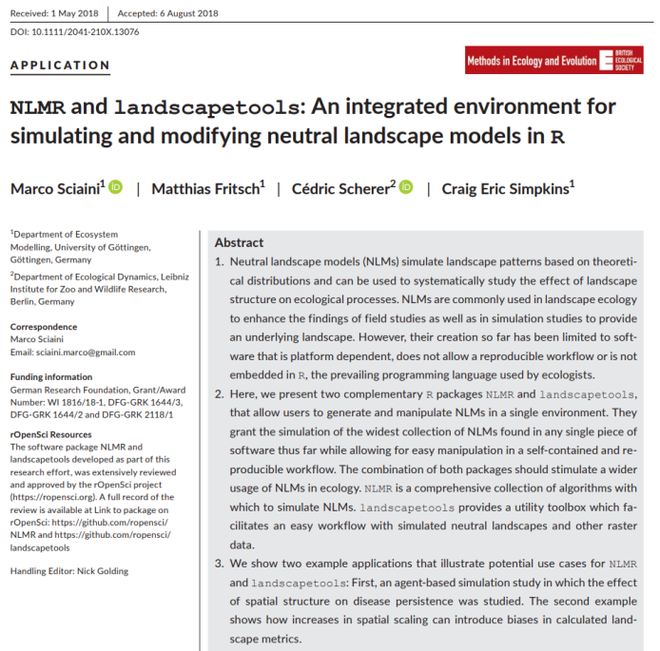
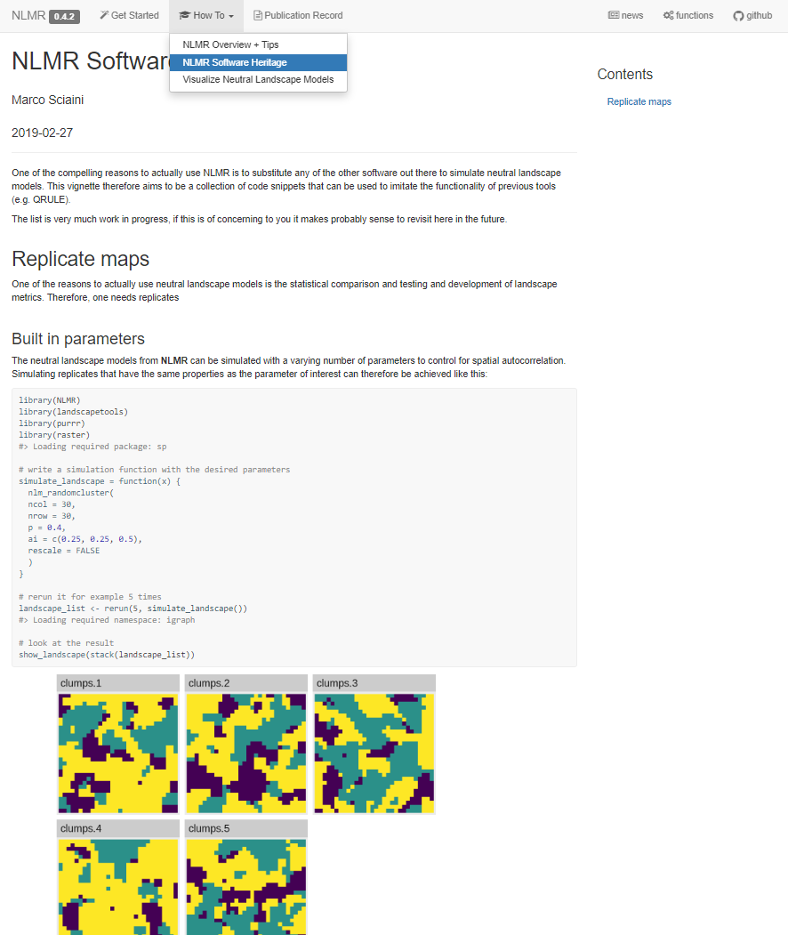
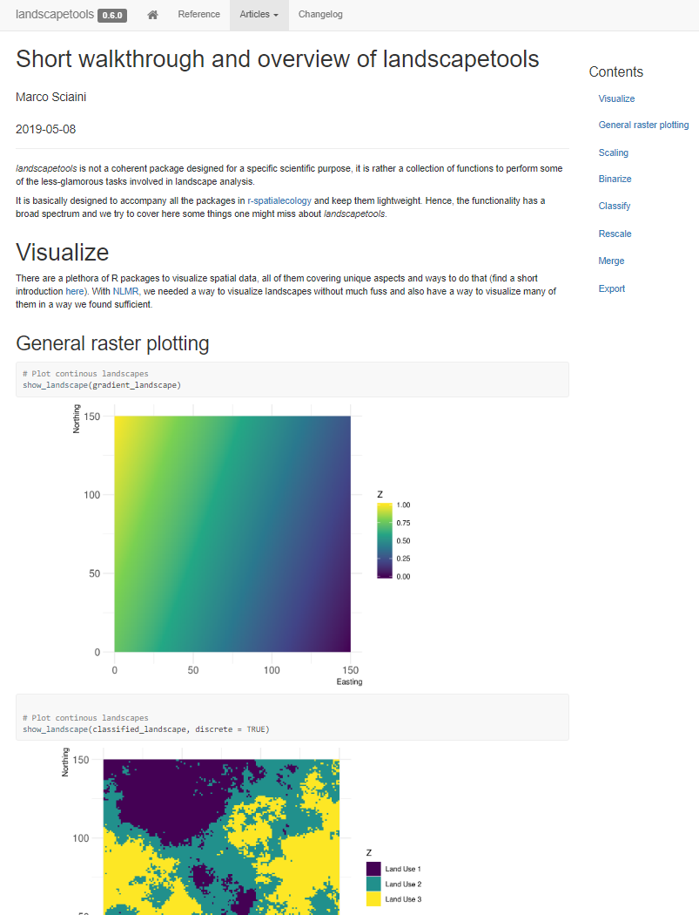
Resources
Extensive documentation, walk-through & tips:
ropensci.github.io/NLMR/
ropensci.github.io/landscapetools/
Publication in Methods in Ecology & Evolution
doi.org/10.1111/2041-210X.13076
Cédric Scherer cedricscherer.netlify.com @CedScherer

Slide 13
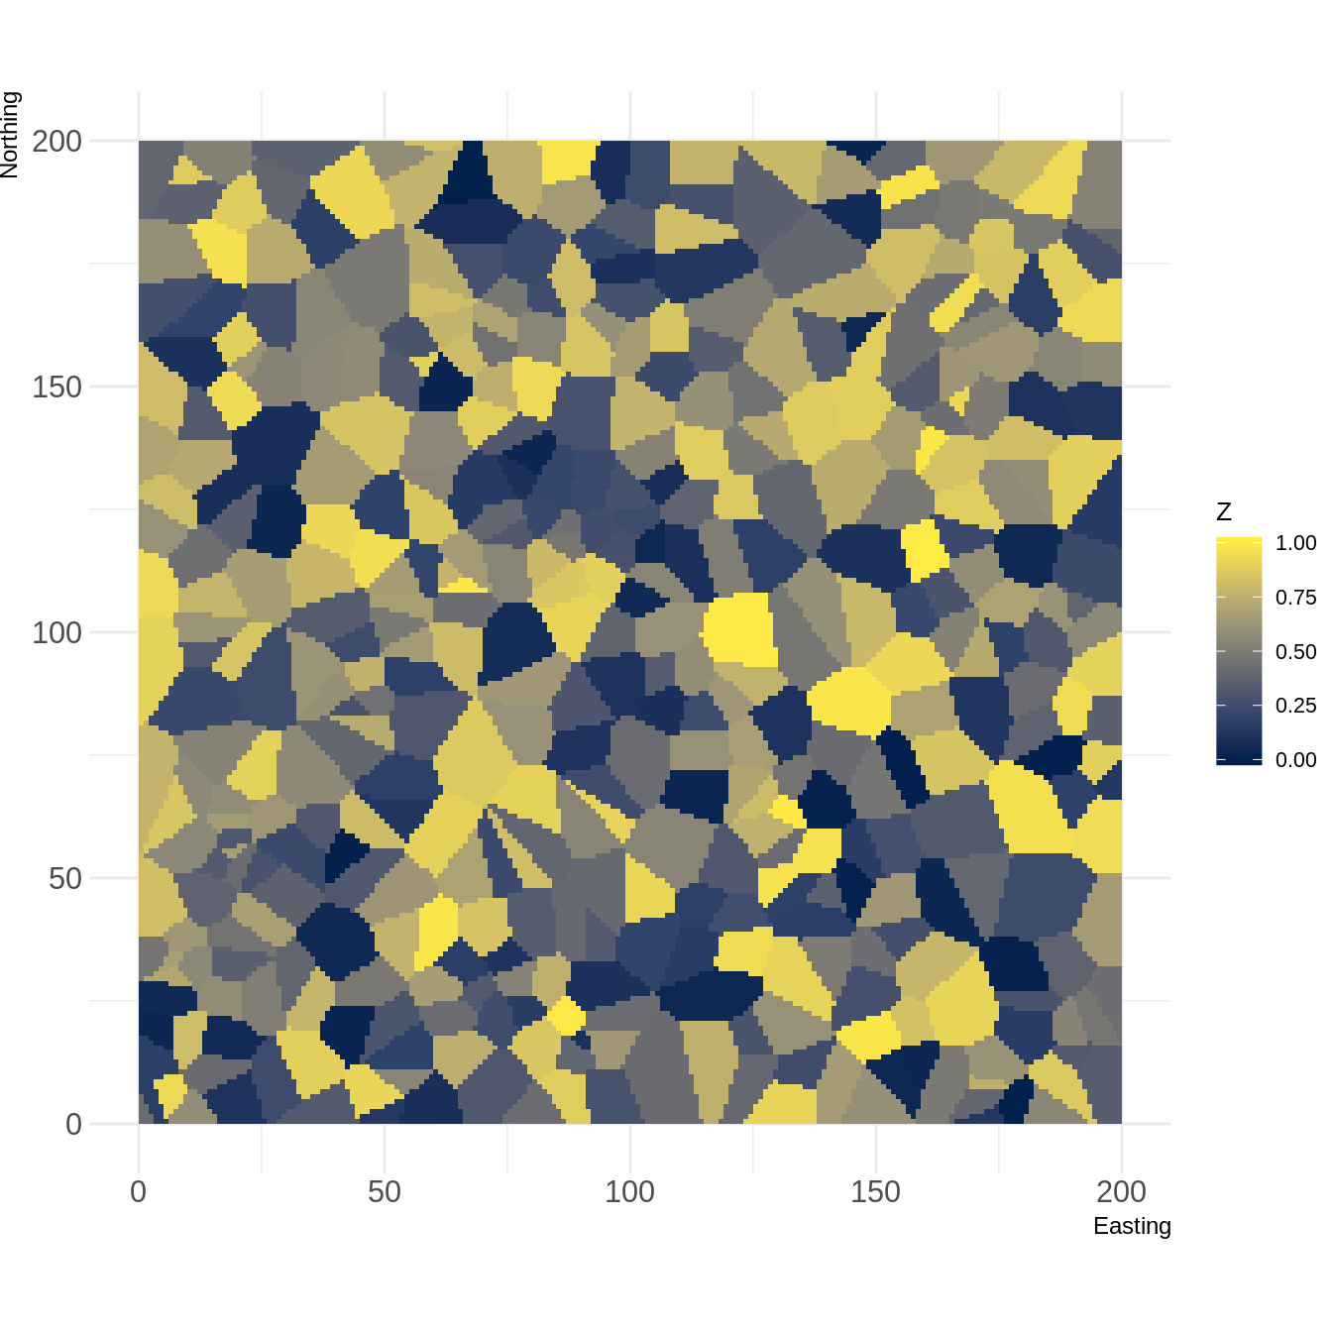
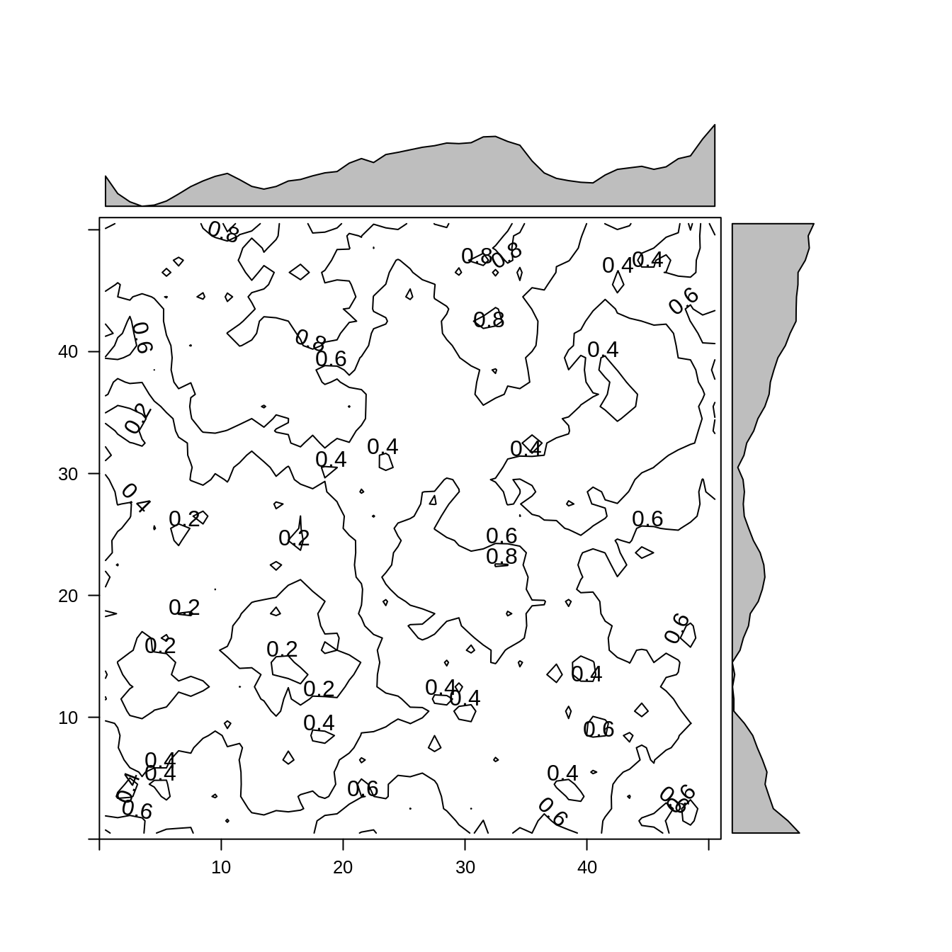
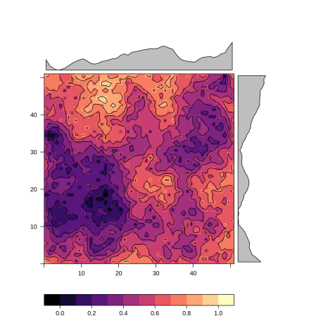
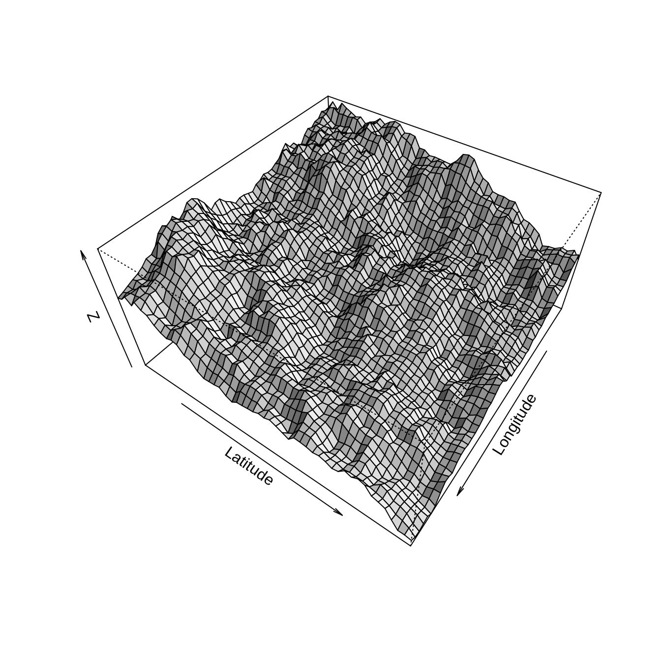
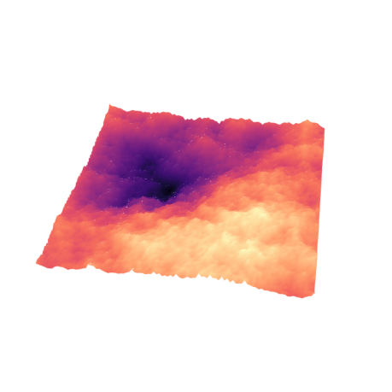
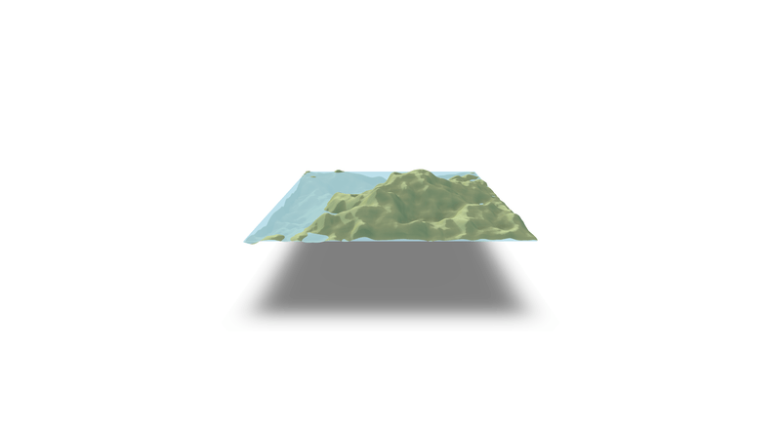
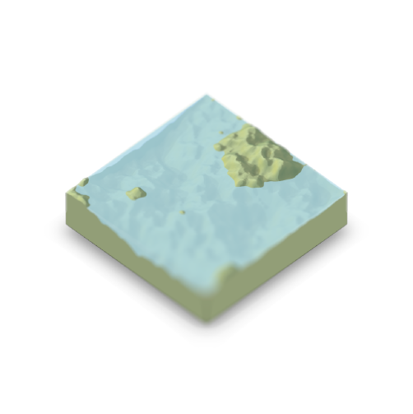



Resources
e.g. guide on "how to visualize raster data"
Cédric Scherer cedricscherer.netlify.com @CedScherer

Slide 14
Resources
Extensive documentation, walk-through & tips:
ropensci.github.io/NLMR/
ropensci.github.io/landscapetools/
Publication in Methods in Ecology & Evolution
doi.org/10.1111/2041-210X.13076
Cédric Scherer cedricscherer.netlify.com @CedScherer

Slide 15
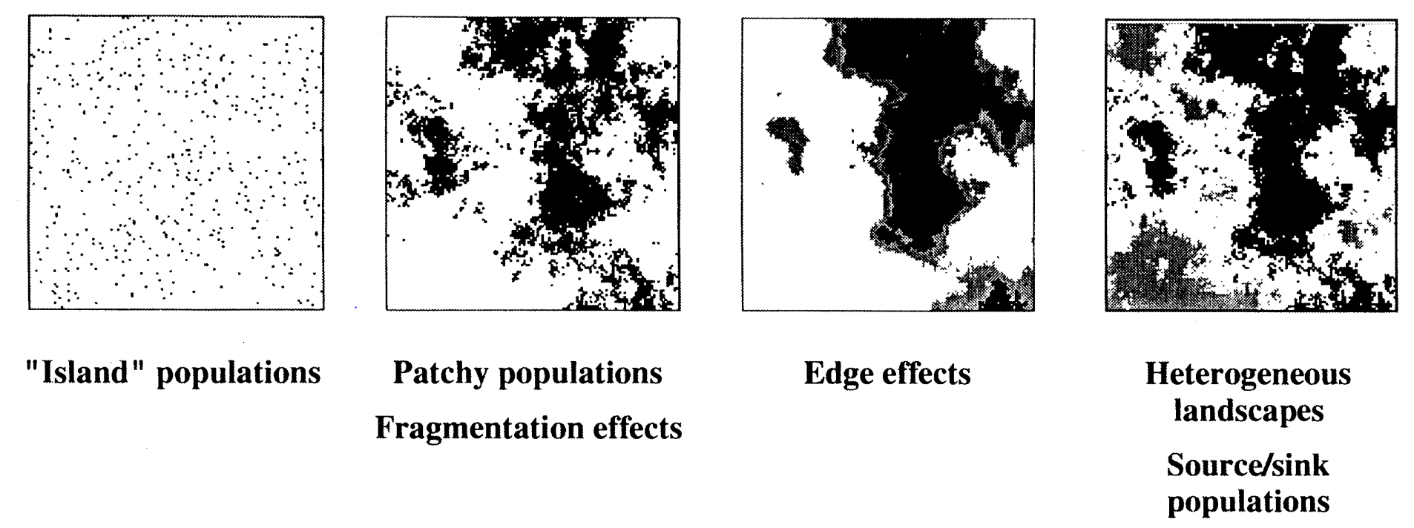
Neutral Landscape Models (NLMs)
Algorithms which generate landscape patterns based on theoretical distributions (Caswell 1976, Gardner et al. 1987, Li et al. 2004)
With (1997) Conserv. Biol. 79:219–229

Slide 16
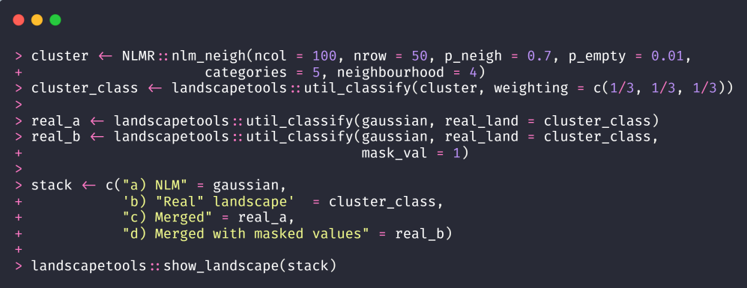
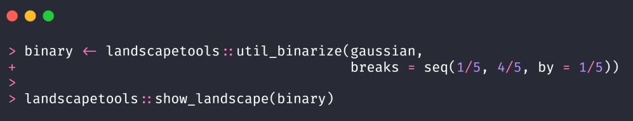
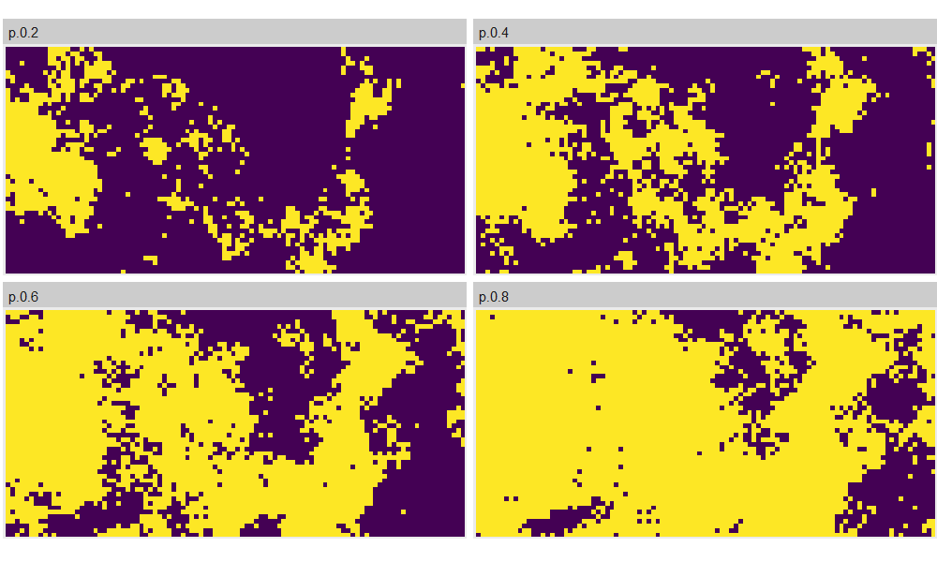
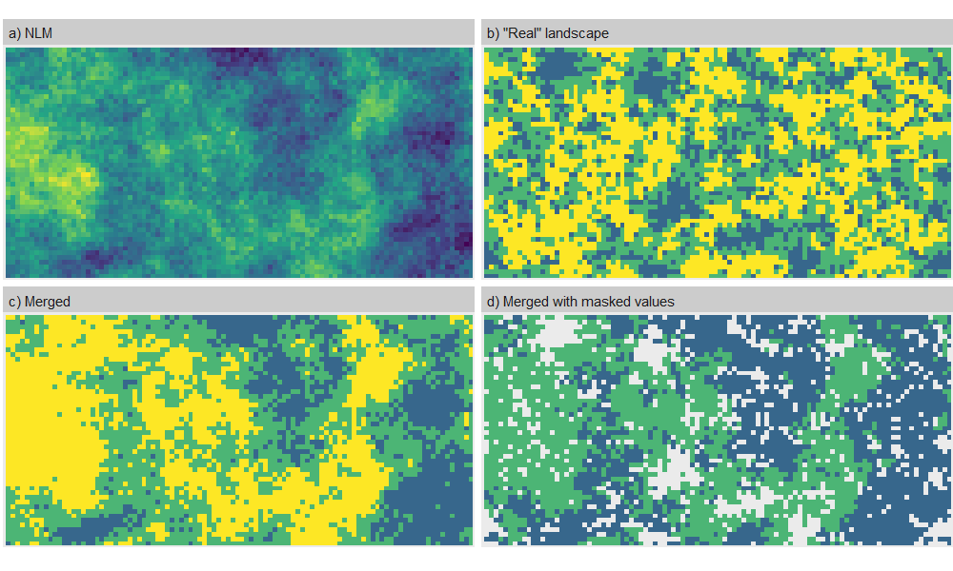
{landscapetools}

